Slide 1

LOAN APPROVAL PREDICTION SYSTEM

Slide 2
TEAM MEMBERS
DURGA SYAMALA MAREEDU(TEAM LEAD)
SHAIK ASIF ALI
NITHISH KUMAR MAYAVAN
KEERTHI KAPPERA
DATA ANALYSIS
DATA PREPROCESSING
TRAINING AND TESTING
DEPLOYMENT AND APPLICATION

Slide 3
The project aims to develop a predictive model that assesses the creditworthiness of loan applicants.
The primary goal is to minimize the risk associated with loan approval by accurately predicting whether a borrower is likely to default on their loan.
PROJECT
OBJECTIVES

Slide 4
Dataset has been taken from Kaggle.
The training data is used to train the model and learn the patterns and relationships in the data.
The testing data is used to evaluate the performance of the trained model on unseen data.
The accuracy of the model is measured on the testing data to ensure it generalizes well to new data.
DATA SOURCE

Slide 5
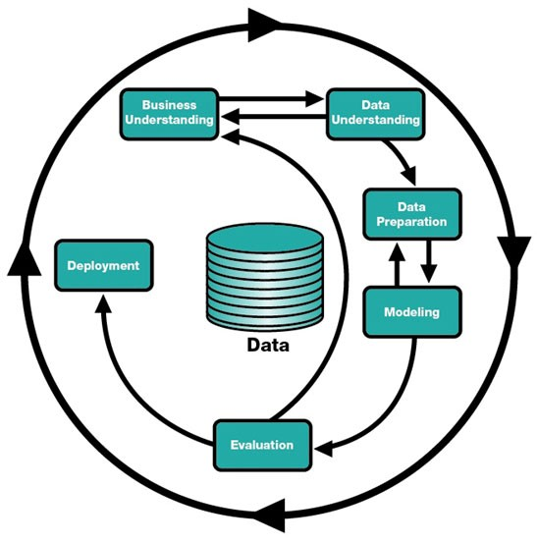
OUR BUSINESS
MODEL

Slide 6
Business understanding for a loan prediction approval system involves comprehending the objectives, requirements, and implications of implementing such a system in a financial institution.
For instance, the bank aims to automate the initial screening process for loan applications to increase efficiency . Stakeholders include loan officers, credit analysts, and management involved in the loan approval process. The system must comply with fair lending practices and data privacy laws .
The system needs credit scores of applicants and loan approval status as historical data . Risk of default is a primary concern, so the system should minimize approving loans to applicants likely to default.
BUSINESS
UNDERSTANDING

Slide 7
DATA UNDERSTANDING
The data understanding involves the process of using statistical and machine learning algorithms to build a model that can accurately predict the outcome of a given problem.
In the case of house price prediction, data modeling involves using various algorithms and techniques to build a model that can predict the potential features influencing loan approval based on a range of factors such as Applicant Income, Education, Loan Amount, number and other relevant features.

Slide 8
DATA PREPARATION
Data preparation is a crucial step in building a loan prediction approval system. It involves collecting, cleaning, preprocessing, and organizing the data to ensure it is suitable for training a machine learning model.
Data preparation using Python and pandas. It includes loading data, cleaning, feature engineering, handling categorical data, scaling numerical features, and splitting the data into training and testing sets using scikit-learn. Remember, actual data preparation steps can vary based on the specific requirements of the loan prediction system and the nature of the dataset available.

Slide 9
MODELING
In this project we have used GuassianNB model (short for Guassian Naïve Bayes) Gaussian Naive Bayes is a probabilistic classification algorithm that is part of the broader Naive Bayes family. It is particularly useful for classification tasks, where the goal is to predict the class of an observation based on its features. The "Naive" in Naive Bayes refers to the assumption of independence between features, which simplifies the underlying probability calculations.
For Gaussian Naive Bayes, estimate the mean and standard deviation of each feature for each class in the training set. These parameters will be used to model the Gaussian distribution.
GuassianNB uses several techniques to improve efficiency and reduce overfitting, such as classification-based algorithms for faster training. This makes it faster and more accurate than other classification methods.

Slide 10
EVALUATION
Evaluating a loan prediction approval system involves assessing the performance of the model(s) built for predicting loan approvals or denials.
We evaluate the performance of our approach using a real-world dataset and compare the results to those obtained using traditional methods.
Our experiments show that our approach can achieve significantly higher accuracy in predicting loan approvals compared to traditional methods.
We conclude by discussing the implications of our findings and potential directions for future work.

Slide 11
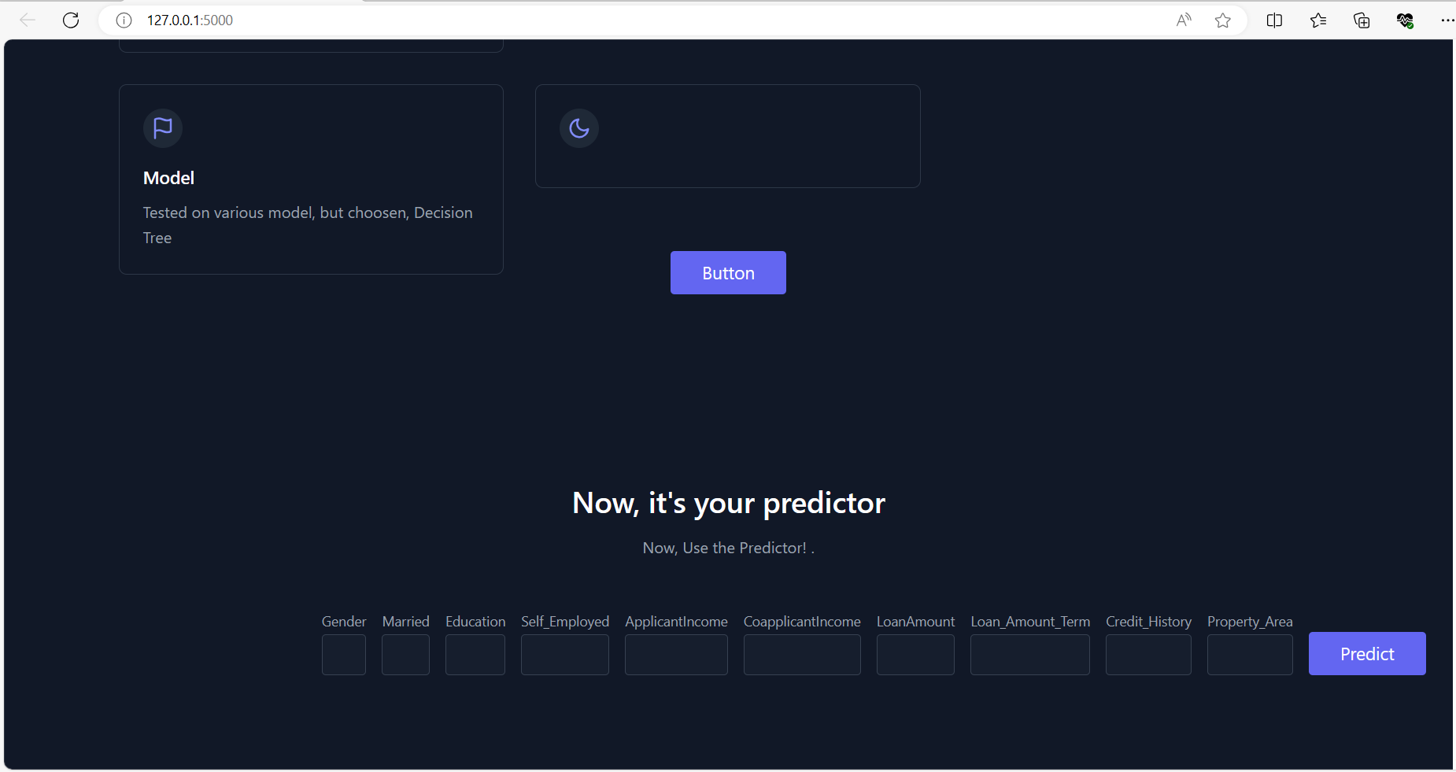
DEPLOYMENT
Deployed the model on the web using flask.
The model can be accessed via local host http://127.0.0.1:5000/predict/
Taken inputs for fields line Gender, Income, Credit score so on to get the answer for our business question.

Slide 12
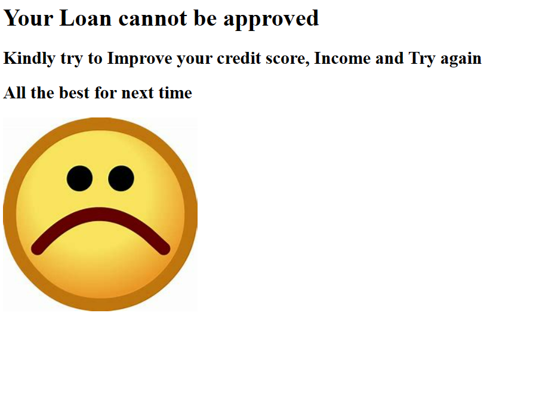
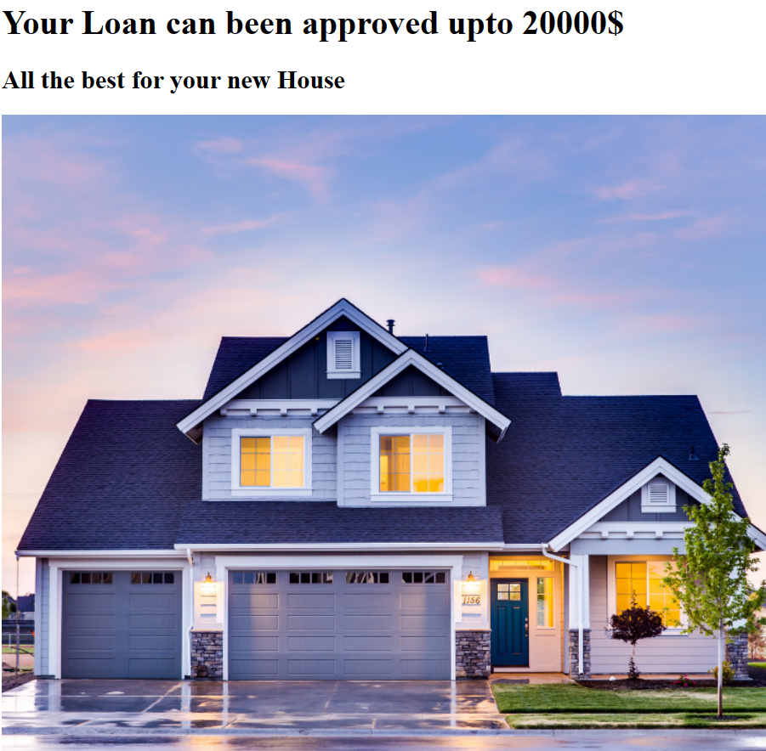
RESULT
Depending upon the credit score and income of the person outputs the loan approvals are calculated and the results are shown below.

Slide 13


